Slide 1
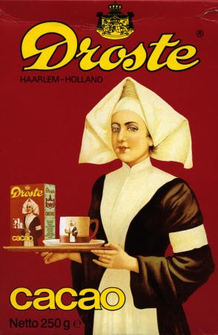
Binary Search

Slide 2
Dictionary lookup
Suppose you’re looking up a word in the dictionary (paper one, not online!)
You probably won’t scan linearly thru the pages – inefficient.
What would be your strategy?

Slide 3
Binary search
def binarySearch(dictionary, word):
if (dictionary has one page): // base case
scan the page for word
else: // recursive case
open the dictionary to a point near the middle
determine which half of the dictionary contains word
if (word is in first half of the dictionary):
binarySearch(first half of dictionary, word)
else:
binarySearch(second half of dictionary, word)

Slide 4
Binary search
Write a method binarySearch that accepts a sorted array of integers and a target integer and returns the index of an occurrence of that value in the array.
If the target value is not found, return -1
index = binarySearch(data, 42) // 10
index2 = binarySearch(data, 66) // -1
index | 0 | 1 | 2 | 3 | 4 | 5 | 6 | 7 | 8 | 9 | 10 | 11 | 12 | 13 | 14 | 15 | 16
value | -4 | 2 | 7 | 10 | 15 | 20 | 22 | 25 | 30 | 36 | 42 | 50 | 56 | 68 | 85 | 92 | 103

Slide 5
Binary search
def binarySearch(sortedArr,num,startIndex,endIndex):
if(startIndex > endIndex):
return -1;
else:
mid = (startIndex + endIndex)/2
if sortedArr[mid]== num:
return mid
elif sortedArr[mid] < num:
return self.binarySearch(sortedArr,num,mid+1,endIndex)
else:
return self.binarySearch(sortedArr,num,startIndex,mid-1)
def binSearch(sortedArr,num):
return self.binarySearch(sortedArr,num,0,len(sortedArr)-1)

Slide 6
Recursive Algorithms
Example: Tower of Hanoi, move all disks to third peg without ever placing a larger disk on a smaller one.

Slide 7
Try to find the pattern by cases
One disk is easy
Two disks...
Three disks...
Four disk...

Slide 8
Recursive Algorithms
Example: Tower of Hanoi, move all disks to third peg without ever placing a larger disk on a smaller one.

Slide 9
Recursive Algorithms
Example: Tower of Hanoi, move all disks to third peg without ever placing a larger disk on a smaller one.

Slide 10
Recursive Algorithms
Example: Tower of Hanoi, move all disks to third peg without ever placing a larger disk on a smaller one.

Slide 11
Recursive Algorithms
Example: Tower of Hanoi, move all disks to third peg without ever placing a larger disk on a smaller one.
Let's go play with it at: http://www.mathsisfun.com/games/towerofhanoi.html

Slide 12
Fractals – the Koch curve

Slide 13
Simpler example: cCurve
Can you draw
the next one???

Slide 14
Other growth phenomenon: cCurve
The next one is: the previous one rotated left plus
the previous one rotated right

Slide 15
CCurve code
/** Recursive function which draws a CCurve
* @param rank of the CCurve
* @param angle initial angle of the CCurve
*/
def cCurve(int rank, int angle):
if rank <= 0:
addLine(angle)
else:
cCurve(rank - 1, angle - 45)
cCurve(rank - 1, angle + 45)

